Slide 1
Analysis of Algorithms

Slide 2
Why sort
Sorting used as a step in many algorithms
Easier to introduce the concept of design and analysis of algorithms.

Slide 3
Insertion sort
Works the same way you arrange your hand when playing cards.
Pick up a card and place it in your hand in the correct position relative to the cards you’re already holding.

Slide 4
Arranging a hand of cards
7
5
7

Slide 5
Arranging a hand of cards
5
7
5
6
7
5
6
7
K
5
6
7
8
K

Slide 6
Insertion Sort
7
K
7
5
1
7
5
7
2
5
7
3

Slide 7
Insertion Sort (cont.)
5
7
6
K
5
7
1
5
7
6
5
2
7
5
6
7
3

Slide 8
Insertion Sort (cont.)
5
6
7
K

Slide 9
Insertion Sort (cont.)
5
6
7
K
8
5
6
7
K
8
1
5
6
7
K
8
5
6
7
K
2
5
6
7
8
K
3

Slide 10
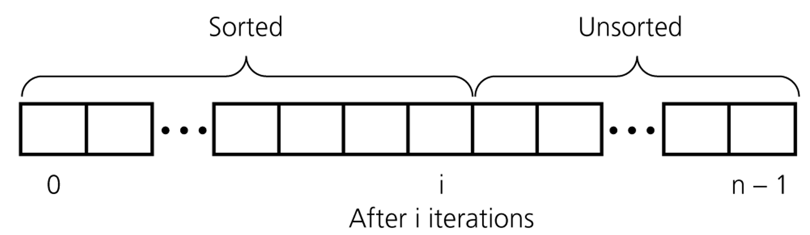
Insertion sort – more formally
insertion sort partitions the array into two regions: sorted, and unsorted
each iteration the sorted part grows by 1

Slide 11
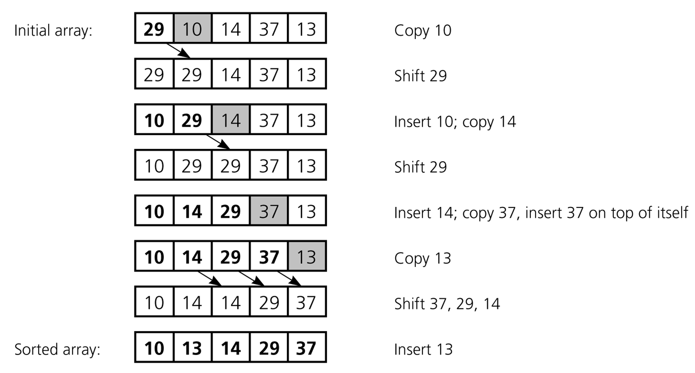
Insertion sort – another example

Slide 12
Insertion Sort Algorithm
def insertionSort(arr):
for j in xrange(1,len(arr))
key = arr[j]
i = j - 1
// shift larger values to the right
while (i > -1 and arr[i] > key):
arr[i+1] = arr[i]
i--
// insert the current item
arr[i+1] = key;

Slide 13
Loop Invariant
For correctness we will use loop invariance
What is it?

Slide 14
Loop Invariant for Insertion Sort
At the start of each iteration, the subarray arr[0….j-1] is a sorted array
To use a loop invariant to prove correctness we must show three things about it:
Initialization: It is true prior to the first iteration
Maintenance: If it is true before an iteration of the loop, it remains true before the next iteration
Termination: When the loop terminates, the property holds true.

Slide 15
Analysis of Algorithms
We use an algorithm’s running time.
Each instruction such as:
Arithmetic: add, subtract, multiply, divide, remainder etc.
data movement: load, store, copy
control: conditional / unconditional branch, subroutine call and return
takes a constant amount of time.

Slide 16
Insertion Sort Algorithm
Cost times
c1 n
c2 n-1
c3 n-1
0 n-1
c5 ∑j=1^{n} tj
c6 ∑j=1^{n (}tj -1)
c7 ∑j=1^{n} (tj - 1)
0 n - 1
c9 n - 1
def insertionSort(arr):
for j in xrange(1,len(arr))
key = arr[j]
i = j - 1
// shift larger values to the right
while (i > -1 and arr[i] > key):
arr[i+1] = arr[i]
i--
// insert the current item
arr[i+1] = key;
//Assuming len(arr) = n

Slide 17
Running Time
The running time of an algorithm is
∑ (cost of a statement) . (number of times statement is executed)
Let T(n) = running time of Insertion sort
T(n) = c1n + c2 (n-1) + c3(n-1) + c5∑j=1^{n} tj + c6∑j=1^{n} (tj - 1) +
c7∑j=1^{n} (tj - 1) + c9 (n-1)
The running time depends on the values of tj . These vary according to the input.
What is the best case?
all statements

Slide 18
Running time best case
The array is already sorted
Always find that arr[i] ≤ key upon the first time the while loop test is run
All tj are 1
Running time is
T(n) = c1n + c2 (n-1) + c3(n-1) + c5(n-1) + c9 (n-1)
= ( c1 + c2 + c3 + c5 + c9 ) n - ( c2 + c3 + c5 + c9 )
T(n) can be expresses as an + b for constants a and b that depend on the statement costs ci => T(n) is a linear function of n

Slide 19
Worst Case
The array is in the reverse order
Always find that arr[i] > key in while loop test
Have to compare key with all elements to the left of the jth position => compare with j-1 elements
Since the while loop exits because i reaches 0, there is one additional test after j-1 tests => tj = j.
∑j=2^{n} tj = ∑j=2^{n} j and ∑j=2^{n} (tj - 1) = ∑j=2^{n} (j - 1)
∑j=1^{n} j is known arithmetic series
What does it equal to?

Slide 20
Worst Case
∑j=1^{n} j = n(n+1) / 2
Therefore ∑j=2^{n} j = (n(n+1) / 2) - 1
let us say k = j-1, therefore ∑j=2^{n} (j -1) = ∑k=1^{n-1} k = n(n-1) / 2
Running time is T(n) = c1n + c2 (n-1) + c3(n-1) + c5(n(n+1)/2 - 1) + c6(n(n-1)/2) +
c7(n(n-1)/2)+ c9 (n-1) = ( c5 / 2 + c6 / 2 + c7 / 2 ) n² + (c1 + c2 +c3 + c5 / 2 - c6 / 2 - c7 / 2 + c9 )n
- ( c2 + c3 + c5 + c9)
T(n) can be expressed as an² + bn + c

Slide 21
Worst case and average case analysis
We usually concentrate on finding the worst-case running time. The longest running time for any input of size n
Why?
It gives a guaranteed upper bound on running time for any input.
Why not analyze the average case? Because it is often as bad as the worst case.
Suppose that we randomly choose n numbers as the input to insertion sort. On average the key arr[j] is less than half of the elements of arr[1…. j-1] and it’s greater than the other half

Slide 22
Average case
On average the while loop has to look halfway through the sorted subarray arr[1…. j-1] to decide where to drop key
=> tj ≈ j/2
Although the average-case running time is approximately half of the worst case running time, it is still a quadratic function of n

Slide 23
Order of growth
Another abstraction to ease analysis and focus on the important features
Look only at the leading term of the formula for running time.
drop lower order terms
ignore the constant coefficient in the leading term

Slide 24
Order of growth
For insertion sort we already abstracted the actual statement costs to conclude that the worst-case running time is an² + bn + c drop lower order terms => an² Ignore constant coefficient => n² But we cannot say that the worst case running time T(n) equals n² It grows like n² but it doesn’t equal n² We say that the running time theta (n²) to capture the notion that the order of growth is n²

